Slide 1
Test and Backlog Driven
Agile DWH-ing
Christoph Seck Senior Consultant

Slide 2
Topics
BI is different
Practices
Agile
There is more …

Slide 3

BI is different

Slide 4
Simple
Cube
Core
Star
Staging
Source

Slide 5
Complex

Slide 6
Complex
Requirements

Slide 7


Slide 8
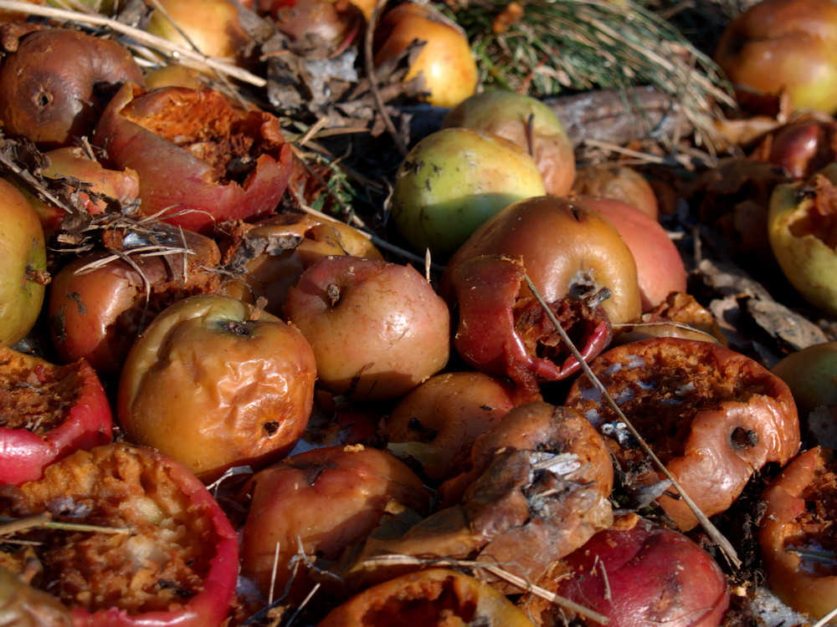

Slide 9
Complex
Requirements

Slide 10
Complex
Source
Requirements
Business Processes

Slide 11
Complex
Source
Stakeholder
Politics
Requirements
Business Processes

Slide 12
Simple
Complex

Slide 13
In “Scrum”
Defined
Empirical
Notes:
Ken Schwaber:
http://controlchaos.squarespace.com/storage/scrum-articles/scrumhard.pdf

Slide 14
Points of Interest
Fixed Price
Simple // Complex
Scaling

Slide 15

Practices
Notes:
Test Driven/Backlog Was ist wichtiger?
Bsp. Scrum No Tests necessary

Slide 16
Test Driven
Back Log

Slide 17

Backlog
Notes:
Prios

Slide 18


Slide 19
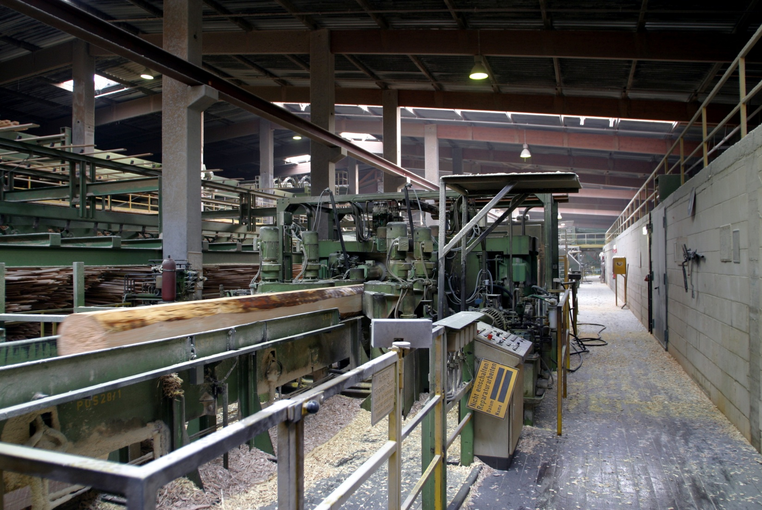

Slide 20
Backlog
Tasks
Packages
Notes:
Packages: Tasks nicht notwendig unabhängig, Packages sind unabh. Gruppen von Tasks
Wie werden Packages geschnürt?

Slide 21
Packages
Technic
Value
Notes:
1. : Package muss Kunden-Value liefern (nicht jede Task tut das)

Slide 22
Packages
Technic
User Story

Slide 23
Packages
Technic
Data Story
Notes:
Bsp Data Story
Übergang Data Story Cube

Slide 24
Data Stories
Product is Sold
Part is Used
Notes:
Bsp Data Story ->

Slide 25
Data Stories
Product is Sold
at Date
Part is Used
in Product
Notes:
Bsp Data Story ->

Slide 26
Data Stories
Product of Type is Sold
at Date
Part by Supplier is Used
in Product
Notes:
Bsp Data Story ->

Slide 27
Data Stories & Bus Matrix
 | Product | Part | Date | Release | Type | Scenario | Supplier
Revenue | * |  | * |  | * | *
# Products Sold | * |  | * |  | * | *
Margin | * |  | * |  | * | *
# Parts | * | * |  | * | * |  | *
# Parts Sold | * | * | * | * | * |  | *
Notes:
Kimball: Bus Matrix(Design Tip #155 Going Agile? Start with the Bus Matrix (http://www.kimballgroup.com/2013/05/01/design-tip-155-going-agile-start-with-bus-matrix-2/)
Lawrence Corr und Jim Stagnitto : Agile Data Warehouse Design
Ralph Hughes: Agile Data Warehousing Project Management

Slide 28
Data Stories & Bus Matrix
 | Product | Part | Date | Release | Type | Scenario | Supplier
Revenue | * |  | * |  | * | *
# Products Sold | * |  | * |  | * | *
Margin | * |  | * |  | * | *
# Parts | * | * |  | * | * |  | *
# Parts Sold | * | * | * | * | * |  | *
Notes:
Kimball: Bus Matrix(Design Tip #155 Going Agile? Start with the Bus Matrix (http://www.kimballgroup.com/2013/05/01/design-tip-155-going-agile-start-with-bus-matrix-2/)
Lawrence Corr und Jim Stagnitto : Agile Data Warehouse Design
Ralph Hughes: Agile Data Warehousing Project Management

Slide 29
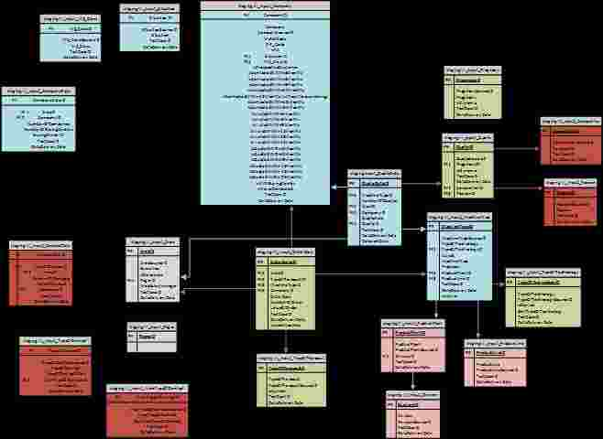
Abstraction Layer
Notes:
Just Add -> Backlog Smoothing -> Data Vault

Slide 30
Abstraction Layer
Source Specificaton

Slide 31
Bus Matrix
Abstr. Layer
Source Spec
Deploy
Stories
Dev
Prios

Slide 32
Bus Matrix
Abstr. Layer
Source Spec
Deploy
Stories
Dev
Prios
Backlog Building

Slide 33
Cube
Core
Star
Staging
Source

Slide 34
Testing
Test Data
Test Data
Test Case Target
Cube

Slide 35
Testing
Test Data
Test
Test Data
Test Case Target
Cube

Slide 36
Abstr. Layer
Source Spec.
Dev
Tests
Deploy
Backlog
Test Cases

Slide 37
Abstr. Layer
Spec.
Dev
Tests
Deploy
Backlog
Test Cases

Slide 38
Abstr. Layer
Spec.
Dev
Tests
Deploy
Backlog
Test Cases
Abstr. Layer
Spec.
Dev
Tests
Deploy
Backlog
Test Cases
Abstr. Layer
Spec.
Dev
Tests
Deploy
Backlog
Test Cases
Abstr. Layer
Spec.
Dev
Tests
Deploy
Backlog
Test Cases

Slide 39

Acceptance Criteria
Tests

Slide 40
Fair Risk Sharing
Risk Assessment
Estimation

Slide 41
Fair Risk Sharing
Source Structure
Key Figure Definitions
Data Quality
Business Processes

Slide 42
Points of Interest
Fixed Price
Simple // Complex
Scaling

Slide 43
Points of Interest
Fixed Price
Simple // Complex
Scaling

Slide 44

Agile
Notes:
Wurzeln -> Next

Slide 45
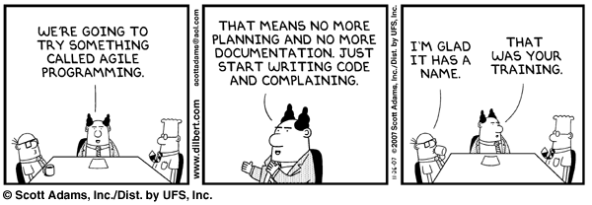

Slide 46
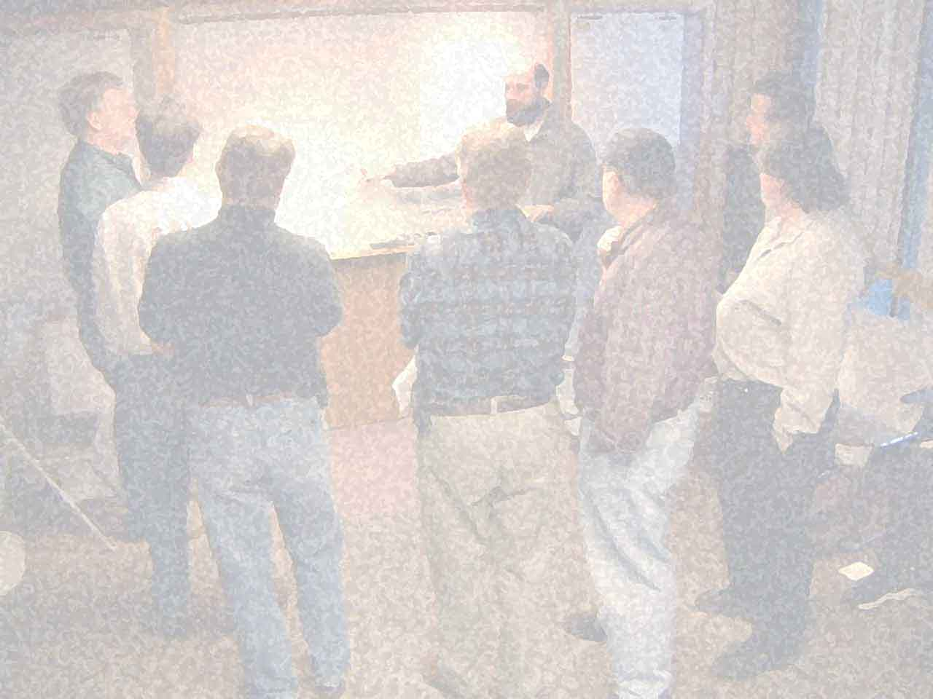
Manifesto for Agile Software Development
We are uncovering better ways of developing software by doing it and helping others do it. Through this work we have come to value:
Individuals and interactions over processes and tools Working software over comprehensive documentation Customer collaboration over contract negotiation Responding to change over following a plan
That is, while there is value in the items on the right, we value the items on the left more.
Notes:
Utah Feb 2001

Slide 47
Principles behind the Agile Manifesto We follow these principles:
Our highest priority is to satisfy the customer through early and continuous delivery of valuable software.
Welcome changing requirements, even late in development. Agile processes harness change for the customer's competitive advantage.
Deliver working software frequently, from a couple of weeks to a couple of months, with a preference to the shorter timescale.
Business people and developers must work together daily throughout the project.
Build projects around motivated individuals. Give them the environment and support they need, and trust them to get the job done.
The most efficient and effective method of conveying information to and within a development team is face-to-face conversation.
Working software is the primary measure of progress.
Agile processes promote sustainable development.
The sponsors, developers, and users should be able to maintain a constant pace indefinitely.
Continuous attention to technical excellence and good design enhances agility.
Simplicity--the art of maximizing the amount of work not done--is essential.
The best architectures, requirements, and designs emerge from self-organizing teams.
At regular intervals, the team reflects on how to become more effective, then tunes and adjusts its behavior accordingly.

Slide 48
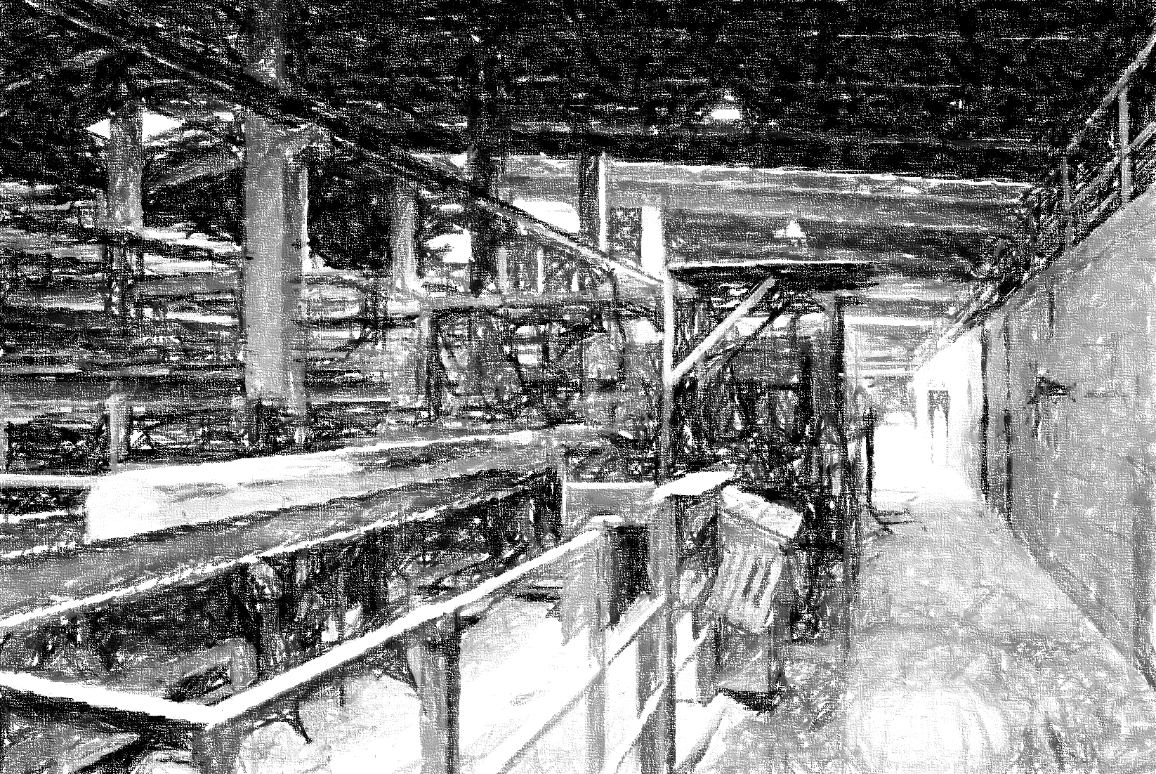

Slide 49
Lean
Identify Value
Strive for Perfection
Map the Value Stream
Establish Pull
Eliminate Waste
Create Flow
Notes:
Eliminate Waste -> Agile is expensive

Slide 50
In Abstracto
Local Optimum
Global Optimum

Slide 51


Agile is expensive
Competence
Convergence
Notes:
Anwenden von „Eliminate Waste“ auf Prozess. Agil ist waste, da wo es nicht klare Vorteile bringt.
=> Scaling Problem

Slide 52

And classical?
Knowledge
Communication

Slide 53
Agile Practices
Test Driven
Back Log

Slide 54
Agile Practices
eXtreme Programming
XP
Scrum

Slide 55
Agile Practices
eXtreme Programming
XP

Slide 56
Cost of Change

Slide 57
XP
Simple Design
Short Releases
On-site Customer
Planning Game
Collective Ownership
40-hour week
Coding Standards
Metaphor
Test Driven
Development
Refactoring
Continuous Integration
Pair Programming

Slide 58
XP Principles
Rapid feedback
Assume simplicity
Quality Work
Incremental change
Embracing change
Notes:
Teach learning
Small initial investment
Play to win
Open, honest communication
Accepted responsibility
Local adaptation

Slide 59
XP
Agil?
Individuals over Processes …

Slide 60

It’s the mix, stupid
Notes:
Blog Eintrag: XP verletzt das Agile Manifest:
"Individuen und Interaktionen mehr als Processes und Werkzeuge."
Kein Projekt etc. ist rein agil oder klassisch
Wir können uns nicht ständig neu erfinden.
Agil & Klassisch auf unterschiedlichen Levels.
Bsp.:
- XP: lokales Wegoptimieren einzelner Praktiken (agil auf Methodenlevel) sabotiert agile Entwicklung. XP beruht auf Kenntnis des EntwicklungsProcessess
Prozessoptimierung: Risiko: Vorteile agiler Einzelprojekte aufgewogen durch Nachteil nicht über Projekte allg. nachdenken zu können. -> Agilität um ein Level verschoben. -> Story in E. Goldratt: Critical Chain
Agil dort wo Kernkompetenzen sind/wo am meisten zu gewinnen ist/das Risiko am größten ist
Im Allgemeinen dort, wo neues Terrain gewonnen wird.

Slide 61
Assess
Enable
Exploit
Protect
Notes:
Backlog Glätten, (Data Vault)
Agiles Prinzip
Schützen (TestBased)
Wo Investieren (Kanban)

Slide 62
Points of Interest
Fixed Price
Simple // Complex
Scaling

Slide 63
Points of Interest
Fixed Price
Simple // Complex
Scaling

Slide 64

There is more …
Notes:
Other Variants:
Self Service BI
Logical DWH (Data Virtualization)
Agile PM

Slide 65
Data Vault
Mix:
3NF
Star
Historize
No Structural Changes
Just Add
Notes:
Hub, Link Satelite, Reference

Slide 66
Business Keys
M:N Link
Business Keys
Details
Details
Notes:
Hub, Link Satelite, Reference

Slide 67
Hub
Link
Hub
Satellite
Satellite
Notes:
Hub, Link Satelite, Reference

Slide 68

Kanban
Notes:
Imperial Garden

Slide 69
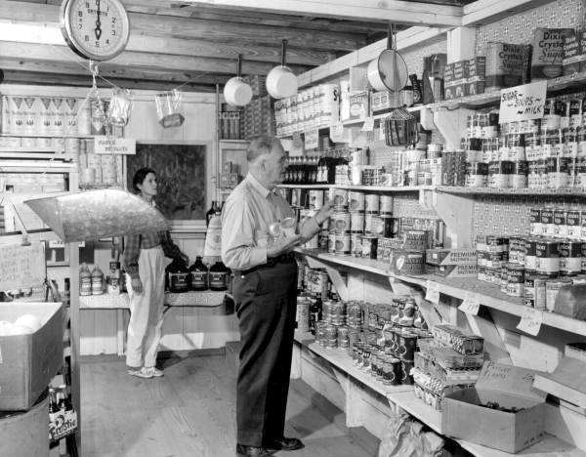
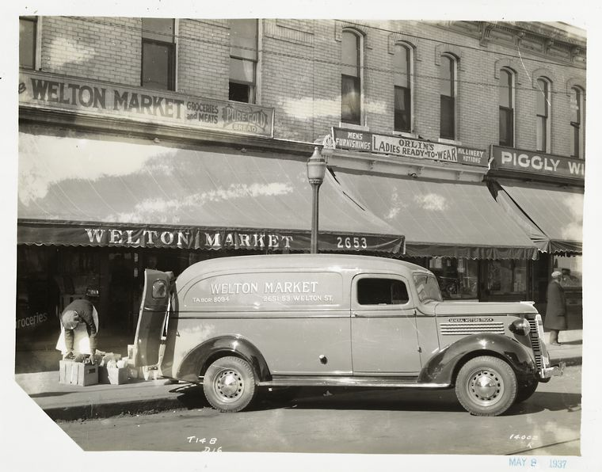
Introduced: Toyota 1953
Toyota Production System
„Signal Card“
Idea of american Supermarkets
Notes:
Ursprung: Supermarkt
Jedes Teil immer mit Karte. Geht das teil an einen Kunden wird die Karte frei & ich kann nachbestellen
Toyota Production System

Slide 70
Identify Value
Strive for Perfection
Map the Value Stream
Establish Pull
Eliminate Waste
Create Flow

Slide 71
Visualize Workflow
Limit Work in Progress

Slide 72
Throughput
Visualize Workflow
Limit Work in Progress

Slide 73
WIP
Value
WIP
Backlog
Notes:
WIP Kette ist in Scrum Blackbox
Little‘s Law (WIP = #Incomming (per Week) * Weeks In)

Slide 74
4
2
To do
Ready
Work In Progress
Done
Anne
Paul
Jim
Anne

Slide 75
4
2
To do
Ready
Work In Progress
Done
Anne
Paul
Anne

Slide 76
4
2
To do
Ready
Work In Progress
Done
Anne
Paul
Jim
Anne

Slide 77
4
2
To do
Ready
Work In Progress
Done
Anne
Paul
Jim
Anne

Slide 78
2
2
3
3
4
To do
AL
Source Spec
Stage
Core
Star
Done
OK
OK
Jim
Paul
Judith
Jim
Anne
Agnes
Georg
Tom
Anne
Notes:
Development Teams do not contain sub-teams dedicated to particular domains like testing or business analysis. (Scrum Guide - 2011.pdf p. 6)

Slide 79
AL
Spec.
Dev
Tests
Deploy
Backlog
Test Cases
AL
Spec.
Dev
Tests
Deploy
Backlog
Test Cases
AL
Spec.
Dev
Tests
Deploy
Backlog
Test Cases
AL
Spec.
Dev
Tests
Deploy
Backlog
Test Cases

Slide 80
Cumulative Flow Diagram

Slide 81
Cumulative Flow Diagram

Slide 82
Cumulative Flow Diagram
WIP

Slide 83
Cumulative Flow Diagram
WIP
CT

Slide 84
Cumulative Flow Diagram

Slide 85
Cumulative Flow Diagram
WIP
CT

Slide 86
Points of Interest
Fixed Price
Simple // Complex
Scaling

Slide 87
Points of Interest
Fixed Price
Simple // Complex
Scaling

Slide 88
Wrap Up
Simple // Complex
Fixed Price
Scaling
Backlog
Test Driven
Fair Risk Sharing
It’s the Mix …
Throughput
Production //
Construction
Notes:
Practices//Wann Kanban

Slide 89
Thanks
Christoph Seck
c.seck@reply.de

Slide 90
Ressourcen
Anderson, David J. : Agile Management
Anderson, David J. : Kanban
Austin, Robert D.: Measuring and Managing Performance in Organisations
Beck, Ken: extreme Programming explained
Beck, Fowler: Planning extreme Programming

Slide 91
Ressourcen
Boehm, Turner: Balancing Agility and Discipline
Corr, Stagnitto: Agile Data Warehouse Design
Goldratt, Eliyahu M.: The Goal
Highsmith, Jim: Agile Software Development Ecosystems
Hughes, Ralph: Agile Data Warehousing Project Management
Linstedt, Dan: Super Charge Your Data Warehouse: Invaluable Data Modeling Rules to Implement Your Data Vault

Slide 92
Ressourcen
Middleton, Sutton: Lean Software Strategies
Poppendiek, Mary & Tom: Lean Software Development
Reinertsen, Donald G.: Managing the Design Factory
Schwaber, Beedle: Agile Software Development with Scrum

